Slide 1

Voda darian-florian applied data science year 1, semester 2 it & engineering department fh kärnten
Data visualization I
final project proposal

Slide 2
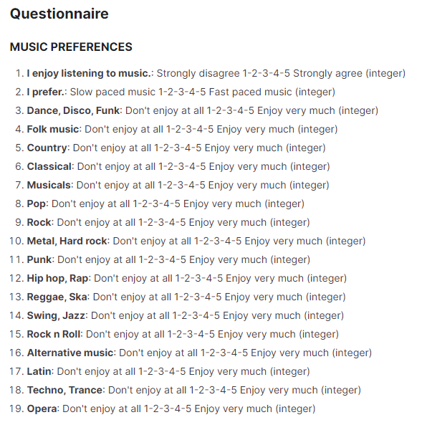
Young people survey - dataset
Visualization: How to effectively visualize a lot of variables in order to gain some meaningful insights from the data?
Year of data collection: 2013
Variables:
Music preferences (19 dimensions)
Movie preferences (12 dimensions)
Hobbies preferences (32 dimensions)
Phobias (10 dimensions)
Health habits (3 dimensions)
Personality traits, views on life & opinions (57 dimensions)
Spending habits (7 dimensions)
Demographics (10 dimensions)
Total number of dimensions: 150 (139 integer, 11 categorical)
Total number of observations: 1010
All participants were of Slovakian nationality, aged between 15-30.
The original questionnaire was in Slovak language and was later translated into English.
Source: Young People Survey – Students in Statistics from FSEV UK

